Slide 1
Sharing Content Between Sites
Tarrant Marshall – Special Broadcasting Service
@aeriadesign
February 7, 2013

Slide 2
Who are SBS?
Special Broadcasting Service
TV & Radio station
Offer multicultural / multilingual content
Government funded & driven by a charter
Also a commercial station

Slide 3
SBS Online presence
http://www.sbs.com.au/
SBS Online is ‘new’
5 years of rapid growth
Offers wide range of websites & apps
OnDemand TV available on all mainstream devices & set top boxes

Slide 4
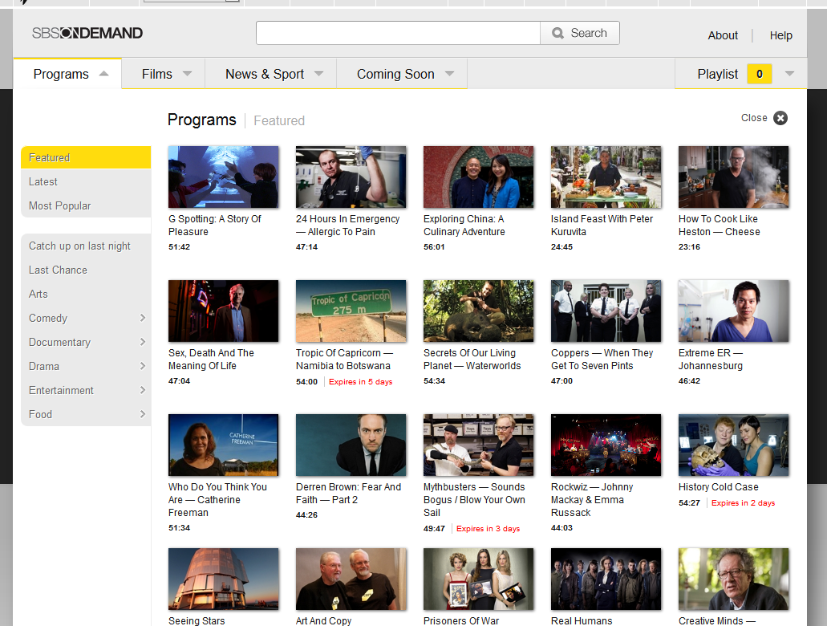
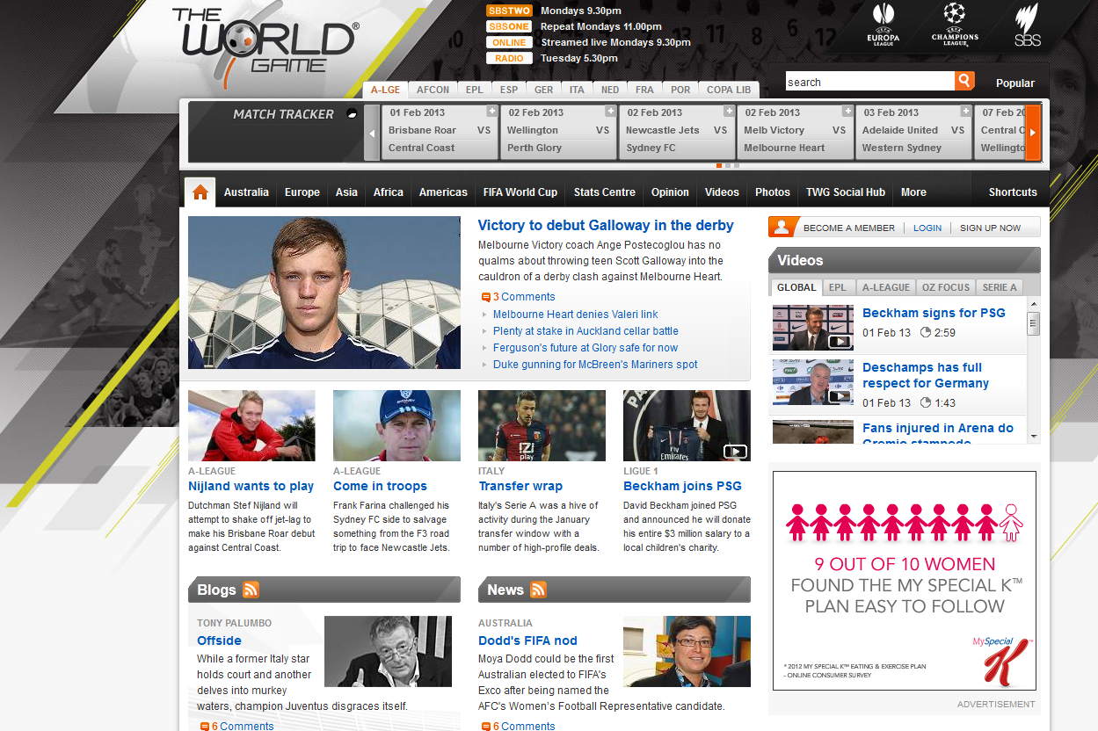
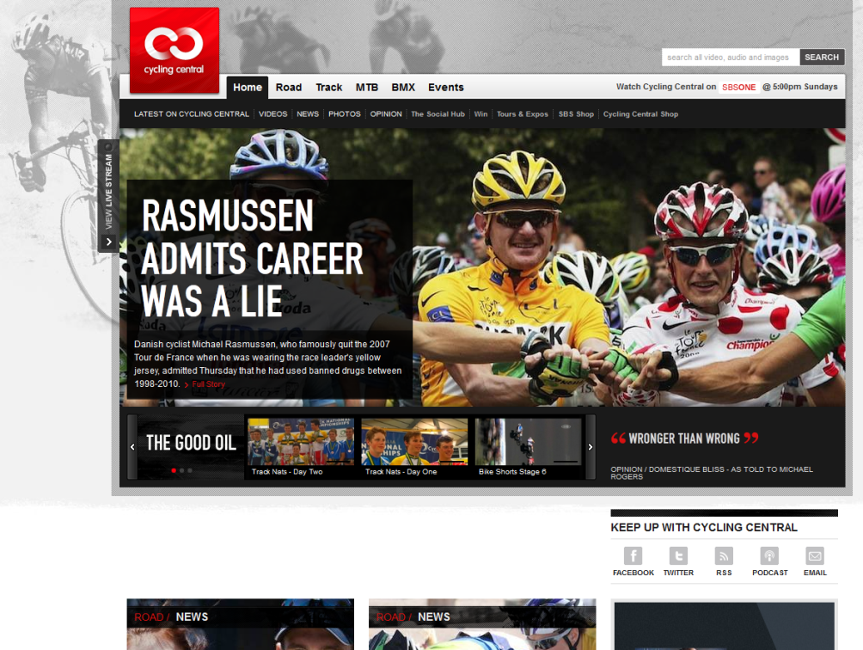
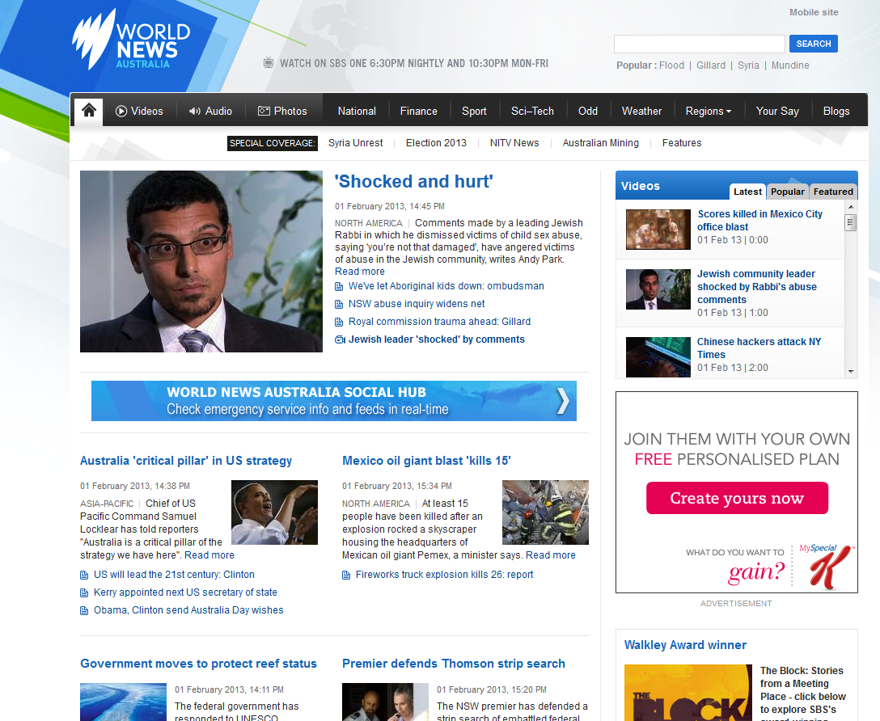
Notes:
sbs.com.au / <site>
News
Sport
Radio
Food
Film
NITV
Shop
Blogs
Documentary
Program sites
... the list goes on

Slide 5
What runs our current sites?
Bespoke CMS in Zend
Very messy and hard to maintain
Changes are too time consuming
Network wide changes – virtually impossible
No consistent look and feel
Poor admin/editor experience
Notes:
For more on our old platform

Slide 6
Where’s Drupal in this picture?

Slide 7
Our goals
Easy to maintain and extend sites
Better user & editor experience
Re-purpose content across the network
Rich meta to find content
New ways to explore content
Multi-device compatible
Use more open source standards & apps
Most of all – Modular and De-coupled
Notes:
Easy to maintain and extend sites
Better user & editor experience
Re-purpose content across the network
Rich meta to find content
New ways to explore content
Multi-device compatible
Use more open source standards & apps
Most of all – Modular and De-coupled

Slide 8
Our goals explored
Many products evaluated – Drupal chosen
One Drupal site? No
Too big of a site & high risk
Not de-coupled
Drupal multi-site? Yes
Shared code? Install profile?
Evaluated existing multi-site methods
Nothing matched what we needed
Notes:
Many products evaluated – Drupal chosen
One Drupal site? No
Too big of a site & high risk
Not de-coupled
Drupal multi-site? Yes
Shared code? Install profile?
Evaluated existing multi-site methods
Nothing matched what we needed

Slide 9
Our goals explored
We discovered we need two parts, not just one:
A website ‘base platform’
Drupal
A common Content Repository (CR)
? ? ?
Notes:
We discovered we need two parts, not just one:
A website ‘base platform’
Drupal
A common Content Repository (CR)
? ? ?

Slide 10
Exploring Standards
So many of them. Really. Too many.
Many solutions to Content Repositories
JCR
PHPCR
Alfresco
Midgard
Drupal?
Or expensive proprietary products
Notes:
Many to choose from – what differentiates them?
How can we tell them apart? List of questions… (NEXT)

Slide 11
Exploring the Content Repository
Questions to help decide:
What does the content look like?
How is it stored behind the scenes?
What supporting DBs, Web, Tomcat, etc.?
What Content types?
What Vocabularies?
Any Image storage?
Any File storage?
How do I search this huge repository?
Notes:
Questions to help decide:
What does the content look like?
How is it stored behind the scenes?
What supporting DBs, Web, Tomcat, etc.?
What Content types?
What Vocabularies?
Any Image storage?
Any File storage?
How do I search this huge repository?

Slide 12
Exploring Standards
What about the communication layer?
SOAP / XML
JSON
PHP Modules (Midgard)
How does one integrate these into Drupal?

Slide 13
Content Repository
Custom – and here’s why:
Not a Java house, JCR
PHPCR is too heavy
Alfresco is not for a real website
Midgard2 was close in theory
Drupal (OpenPublish) was too simple & frontend

Slide 14
Here’s how we did it

Slide 15
Notes:
What we used:
Symfony2
MongoDB
DoctrineODM for MongoDB
Apache Solr 3

Slide 16
Content Repository
Why Symfony2?
Well supported
Great coding standards
Fast and extensible
Doctrine
Existing Symfony2 skill in-house
Cross-skills entire team ahead of Drupal 8

Slide 17
Why Doctrine MongoDB ODM?
We started without ODM for lightweight
Needed more validation & abstraction
ODM = Object Document Mapper
ORM = Object Relational Mapping
Object Document manager
Hey! We have Documents! Articles!
Notes:
Standard Doctrine used is ORM

Slide 18
Content Repository
Why MongoDB?
Easy to use
Very fast
Replication is amazing
MongoDB is a ‘schema-less’ database
We have many content types
And many fields on some content types
Fields are often absent
Notes:
MongoDB is a ‘schema-less’ database
Easy to use
Very fast
Replication is amazing
*CLICK*
We have many content types
And many fields on some content types
Fields are often absent

Slide 19
Content Repository
Why MongoDB?
Actually, Schema-less only to a degree
Pushes struct to Application level
Fast development, stick to your IDE
Data inside MongoDB is thus tidier
One-less validation happening

Slide 20
Content Repository
Content Types
Goal of using Open standards
Schema.org as a strong guide
Freebase as a source and guide
SBS specific content types
e.g. Recipes are ingested, structure is different to Schema.org. Extra fields mostly.
Notes:
Schema.org has many shortfalls. Often fields are not actually how you’d store them in a database. Very useful for a guide though, and assists strongly with rich snippets

Slide 21
Content Types
Content Types
Article
Blog
Person
Recipe
Restaurant
TV Episode
TV Series
TV Season
Just a few to start us, common across network
Easy to extend
Or add new as we go
Notes:
Just a few to start

Slide 22
Glance at what we have now
Symfony2
MongoDB
Drupal
???
JSON
What’s in the middle? Which Standard?
XML?
SOAP?
CMIS?
JSON?
JSON-LD?

Slide 23
Why JSON?
RESTful Service required
Simple & Lightweight
JSON structure close to MongoDB Document
JSON-LD can extend it for that ‘dtd’ feel
Mobile App & Front-end friendly
CMIS is overhead, given our storage db
Can implement more on ‘as needs’. Agile

Slide 24
JSON Service Example
GET /document/{uuid}
PUT /document/{uuid}
Expects JSON in body
DELETE /document/{uuid}
Soft deletes, garbage cleanup monthly
POST /document Not used
Same server-side code as PUT, but would generate a UUID
API is straight forward & adheres to standards.
UUID looks like: 550e8400-e29b-41d4-a716-446655440000
UUID v4 used as ID in our Content Repository
UUID is also Drupal friendly! Module available

Slide 25
JSON Service Example
{
uuid: “550e8400-e29b-41d4-a716-446655440000”,
name: “A news article”,
type: “Article”,
text: “Article body”,
description: “Abstract of the article here”,
dateCreated: 1358035836,
dateModified: 1358035836,
isPublished: 1
}

Slide 26
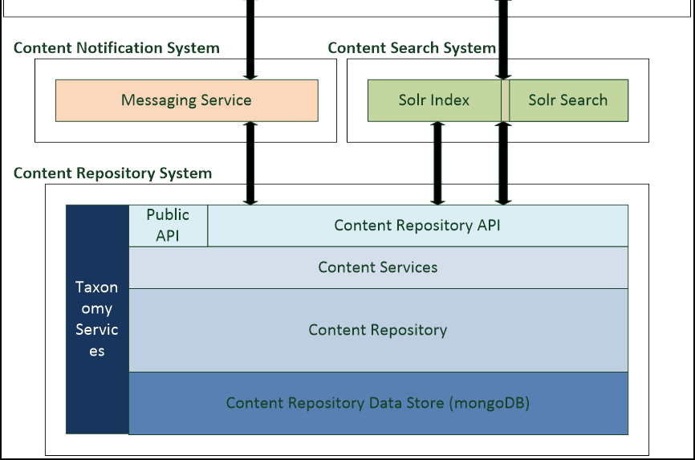
Messaging Queue

Slide 27
Messaging Queue
Required to manage updates across the network
Became the core of the CR design
Feels like a ‘mysql binary log’
Part of the JSON service, Read Only
Example of the Event Object:
{
uuid: “550e8400-e29b-41d4-a716-446655440000”,
sourceUuid: “164h8280-fs9b-418d-a716-1356235123456”,
sourceType: “Document”,
timestamp: 1358035836.12353,
action: “create”
sourceSite: “Food”
}
Notes:
Explain the fields

Slide 28
Messaging Queue
GET /events/since/uuid/{uuid}
GET /events/since/timestamp/{timestamp|1}
Site keeps a pointer of the Event UUID
Site A will be at a different point in queue than Site B
Allows for individual sites to be taken Offline, and ‘catchup’
Sites ignore events that are not relevant to them
Notes:
Can use a ?limit=200 parameter
No pagination

Slide 29
Messaging Queue
550e8400-e29b-41d4-a716-446655440000
29e8d90-28fb-f8d4-a716-446294750280
492a8400-e29b-4a03-abd9-dkb935440d93
xc49esd00-bdw9-adf4-a716-xcvlf84ds900
Site B
Site A
Notes:
Explain the fields

Slide 30
Taxonomy
Long time strength of Drupal
CR required ability to store a common Taxonomy
Sites treat CR taxonomy as One True Taxonomy
Sites update their taxonomies from the Event Queue
Notes:
Explain the fields

Slide 31
Taxonomy
Site A Chicken
Push
CR
Chicken
Pull Queue
Pull Term
Site B
Chicken
Notes:
Eg. Site A creates term ‘Chicken’ in vocab ‘Ingredients’
Site B sees an event for sourceType ‘Terms’, action ‘create’
Site B does a create locally, or a forced update if exists
Terms are unique by their name
Some semi-complex rules around Synchronising here, but basically first in best dressed
UUID in CR is the true UUID – will explain later

Slide 32
CR Search
Mongo’s OK for basic searches
Used Drupal’s Solr schema.xml as a start
Used Solarium library
CR indexing subscribes to Event Queue
Custom Annotation driver
Ties together Doctrine + Solarium
Inline mapping for Document/Entity to Solr Schema
Keeps things simple
Complete Views 3 integration to the CR for read/search
Notes:
Solarium – best library I’ve used

Slide 33
Drupal Install
One Drupal 7 install
One install profile (SBS Distribution)
A ‘global’ theme for all new SBS sites
Sub-themes with overriding artwork
Multi-site installs in a sub-directory structure
/sites/sbs.com.au (homepage)
/sites/sbs.com.au.food
/sites/sbs.com.au.news
Notes:
Pretty stock standard multi-site setup so far

Slide 34
Connecting Drupal
3 parts to the picture
A Drupal Module
A Client API (library)
CR Service (Symfony2)
Client API is standalone, can work outside of Drupal
Client uses PSR-0 namespace
API handles conversion from typed classes to <anything>
Referred to as FieldHandlers, ObjectTranslator
Non-Drupal sites use the Client API
Suite of Drupal 7 Modules to integrate the two

Slide 35
Connecting Drupal
Key Modules:
Server Provider / API Wrapper
Entity Integration (a Field module)
Custom Event Queue processor
Existing Search API + Solr + Sarnia
Custom facet filters where required

Slide 36
Server Provider
Implements Push/Pull/Delete methods
Push/Pull a Drupal entity object through Client API
Handles exceptions
Provides error logging
Uses EntityMetadataWrapper setters/getters

Slide 37
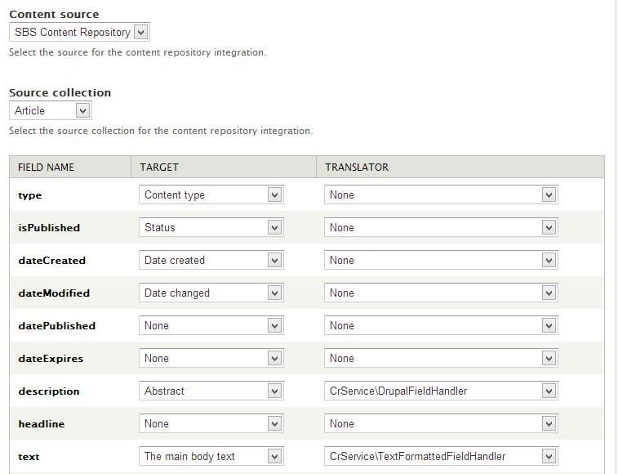
Connecting Drupal
CR Selector (multi capable)
From Client API Schema
Notes:
‘CR’ Field sits on all shared Drupal Content Types
UI to map CR fields => Drupal Fields
All settings are inherently Features Exportable
Choose an API FieldHandler to marry CR structure to Drupal
90% of fields use a generic FieldHandler
Works on Nodes, Vocabs, any Entity
Stores the CR UUID on this field
Owns ‘Sync’ status and ‘Plugins’

Slide 38
Connecting Drupal
Field Handlers to be used
Mapping CR structure <> Drupal
Notes:
‘CR’ Field sits on all shared Drupal Content Types
UI to map CR fields => Drupal Fields
All settings are inherently Features Exportable
Choose an API FieldHandler to marry CR structure to Drupal
90% of fields use a generic FieldHandler
Works on Nodes, Vocabs, any Entity
Stores the CR UUID on this field
Owns ‘Sync’ status and ‘Plugins’

Slide 39
Queue Processor
Exposes Update/Create/Delete queues for Entities
Drupal stores changes in its native DrupalQueue API
Subscribes to CR Event Queue
Initiates Server Provider push/pull hooks for queues
4 main queues:
Push (PUT methods)
Pull
Delete
Event

Slide 40
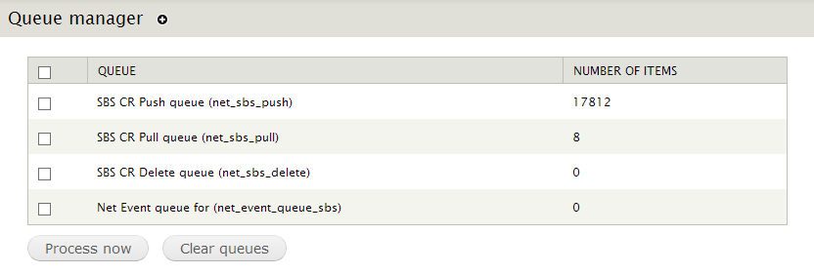
Queue Processor

Slide 41
Queue Processor - Watchdog

Slide 42
Connecting Drupal
Node
save
CR Field
snapshot
DrupalQueue
push
queue
Server
Wrapper
converts
node
Cron
pushes Object
CR Service
fail
persist
json curl
CR Client Api
success

Slide 43
Simple. Right?

Slide 44
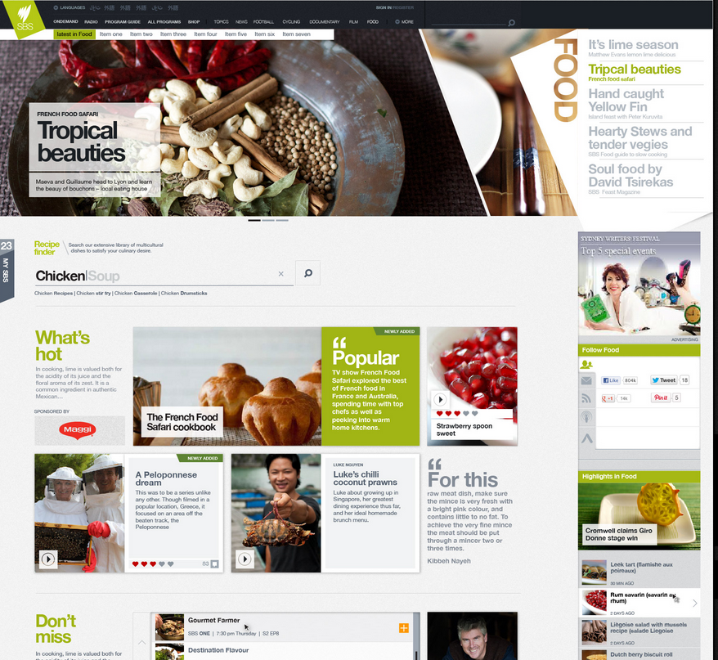

Slide 45
Questions? tarrant.marshall@sbs.com.au @aeriadesign

